Slide 1
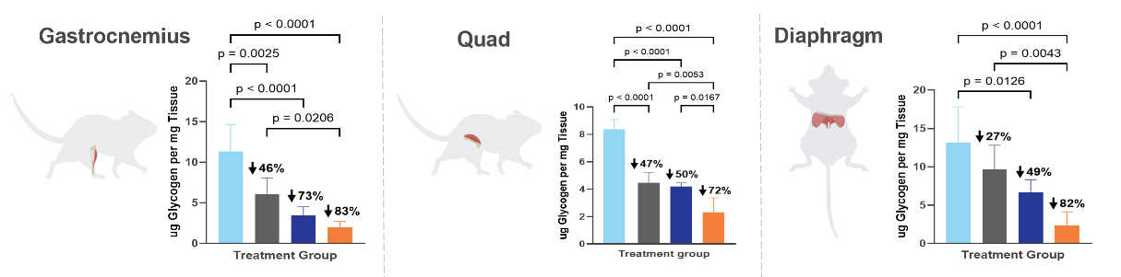
Safety, Tolerability, and Activity of ABX1100, a CD71 Centyrin-siRNA conjugate targeting GYS1 in a Phase 1 Study in Normal Healthy Volunteers
Karyn O’Neil¹, Melissa Brookes¹, Steve Nadler¹, Don Heald¹, Mats Nilsson², Mark Tarnoposky²
¹Aro Biotherapeutics, ² Exerkine
Background
Mechanism of Action
Pompe disease is a rare muscle disease resulting in pathogenic accumulation of glycogen in muscles due to defects in the enzyme responsible for glycogen breakdown. Currently available therapies that deliver a recombinant form of the enzyme (ERT) have limited long term efficacy. In contrast, substrate reduction therapy targeting glycogen synthase 1 (Gys1) would reduce glycogen production and may be a valuable addition or alternative to ERT. We have designed ABX1100, a Centyrin targeting CD71 (TfR1) conjugated to a GYS1 specific siRNA to achieve muscle-selective GYS1 reduction.
Toxic glycogen buildup in Pompe disease is reduced by decreasing expression of glycogen synthase-1 (GYS1) mRNA and protein
POMPE DISEASE
Cytoplasm
POMPE WITH GYS1 mRNA INTERFERENCE
Cell
ABX1100 reduces synthesis of new glycogen, preventing additional build-up in the lysosome
Existing lysosomal glycogen can be metabolized over time by any naturally occurring GAA and/or ERT
ABX1100
Glucose
GYS1
Glucose
GYS1
ABX1100 is comprised of ABX1198, a Centyrin that recognizes human CD71 (TfR1), and ABXO361 an siRNA that specifically cleaves GYS1 mRNA.
Glycogen
Glycogen Synthesis
Decreased glycogen synthesis
Component
Key Features
High affinity binding and specificity for human CD71
Non-competitive with transferrin
Excellent muscle delivery; no activity in liver
Defined conjugation site and efficient GMP scale up
Specific for GYS1 and not GYS2
Proven drug class
Durable PD effect
Glycogen
Centyrin
Receptor binding and internalization enables targeting to specific cells
Linker
Clinical validate and non-cleavable; attached at a single conjugation site
siRNA
Inhibits production of specific protein involved in disease
No glycogen buildup
Deficient GAA
No GAA
Decreased Glycogen Breakdown
Glucose
Decreased glycogen metabolism
Lysosome
Lysosome
Toxic glycogen buildup
GYS1 inhibition restores normal glycogen levels
ABX1100
Reduced GAA function; glycogen buildup in the lysosome
Combining ABX1100 with ERT reduced glycogen significantly more than ERT alone in Pompe Mice
Vehicle
ERT
ABX1100 Surrogate
ABX1100 Surrogate + ERT
Mean + SEM. 4x monthly 18mg/kg ABX1100 surrogate, 7x biweekly 20mpk ERT + 15mpk diphenhydramine, a combination, or vehicle; Male GAA (-/-) Mice. P values calculated using one-way ANOVA. Any comparisons not shown did not reach significance (p ≤0.05)
Study Design
Results: Safety
The Phase 1 study enrolled 37 normal healthy volunteers (NHVs) in 5 cohorts: three single ascending dose cohorts (Part A1-3), one single dose extension cohort (Part A4), and one two-dose cohort (Part B) using short IV administration. Primary and secondary endpoints included safety and tolerability, pharmacokinetics (PK) and GYS1 mRNA knockdown. In Cohorts A1-A3, NHVs received a single dose with muscle biopsies at D29. In A4, NHVs received a single dose with biopsies to D71. In Cohort B, NHVs received two doses (q4w) with biopsies to D71. Biopsies were assessed for Gys1 mRNA and GYS1 protein. Part C is currently enrolling.
ABX1100 was well-tolerated at all dose levels
No SAEs through D85.
No early discontinuations due to an AE.
The most common TEAEs reported considered secondary to the needle muscle biopsy
Most TEAS were transient and mild
No anemia
The most common TEAEs reported in Part A cohorts were blood creatine phosphokinase increases (10 subjects), procedural pain (6 subjects), and asthenia (3 subjects); in Part B were blood creatine phosphokinase increases (4 subjects), procedural pain (3 subjects), and elevated CRP (2 subjects).
There was 1 subject in Cohort A1 who experienced an infusion-related hypersensitivity reaction
Single Dose, Healthy Volunteers
(Completed)
Week 1
Week 2
Week 3
Week 4
Week 5
Week 6
Week 7
Week 8
Week 9
Week 10
A1 - 6 mg/kg (3.3 mg/kg siRNA, n=6)
 | A1 N=6 | A2 N=6 | A3&4 N=11 | A-Placebo N-6 | B N=6 | B-Placebo N=2
Any AE | 3 (50%) | 4 (67%) | 10 (91%) | 4 (67%) | 3 (50%) | 1 (50%)
Mild/Moderate AEs | 3/1 (17/67%) | 4/0 (68/0%) | 8/4 (73/36%) | 4/0 (67/0%) | 3/2 (50/33%) | 1/0 (50/0%)
SAE | 0 | 0 | 0 | 0 | 0 | 0
AEs leading to discontinuation | 0 | 0 | 0 | 0 | 0 | 0
*PBO-controlled
= Dose
A2 - 12 mg/kg (6.6 mg/kg siRNA, n=6)
= Muscle Biopsy
*PBO-controlled
A3 - 18 mg/kg (10 mg/kg siRNA, n=5)
*PBO-controlled
A4 - 18 mg/kg (10 mg/kg siRNA, n=6)
Two Doses, Healthy Volunteers
(Completed)
*Open Label
B - 18 mg/kg (10 mg/kg siRNA, n=6)
Two Doses, LOPD Pts on ERT
*PBO-controlled
Results: Pharmacokinetic
C – Dose TBD
(n=10)
Predictable and well-behaved plasma PK in healthy subjects
*Open Label
Rapid clearance well correlated with NHPs
Inter-subject variability is minimal
Plasma stability for ABX1100 confirmed
Dose proportional Cmax and AUC
Pharmacodynamic (PD) parameters were accurately predicted using PK/PD model based on NHP data
Results: Pharmacodynamic
Dose and time dependent reduction of both GYS1 mRNA and protein observed in single and multi-dose arms of healthy volunteer study
All planned cohorts completed
Dose and time dependent reduction of GYS1 mRNA and protein observed
Two doses of ABX1100 achieve potentially therapeutic levels of GYS1 reduction
Long duration of action supports potential for quarterly maintenance dosing following 1 or 2 loading doses
Conclusions
ABX1100 was well-tolerated at all dose levels
Predictable and well-behaved plasma in healthy subjects and is well correlated with modeled predictions based on NHP studies; no anemia
Dose and time dependent knockdown of GYS1 mRNA and protein
~70% knockdown of GYS1 mRNA and protein was observed at week 10 following 2 doses (Part B)
Loading dose strategy at week 0 and week 4 reduces variability between subjects and improves GYS1 mRNA knockdown
Data confirms safety and GYS1 mRNA target engagement in muscle of NHVs; Ph 1b in LOPD patients currently enrolling.

